Slide 1
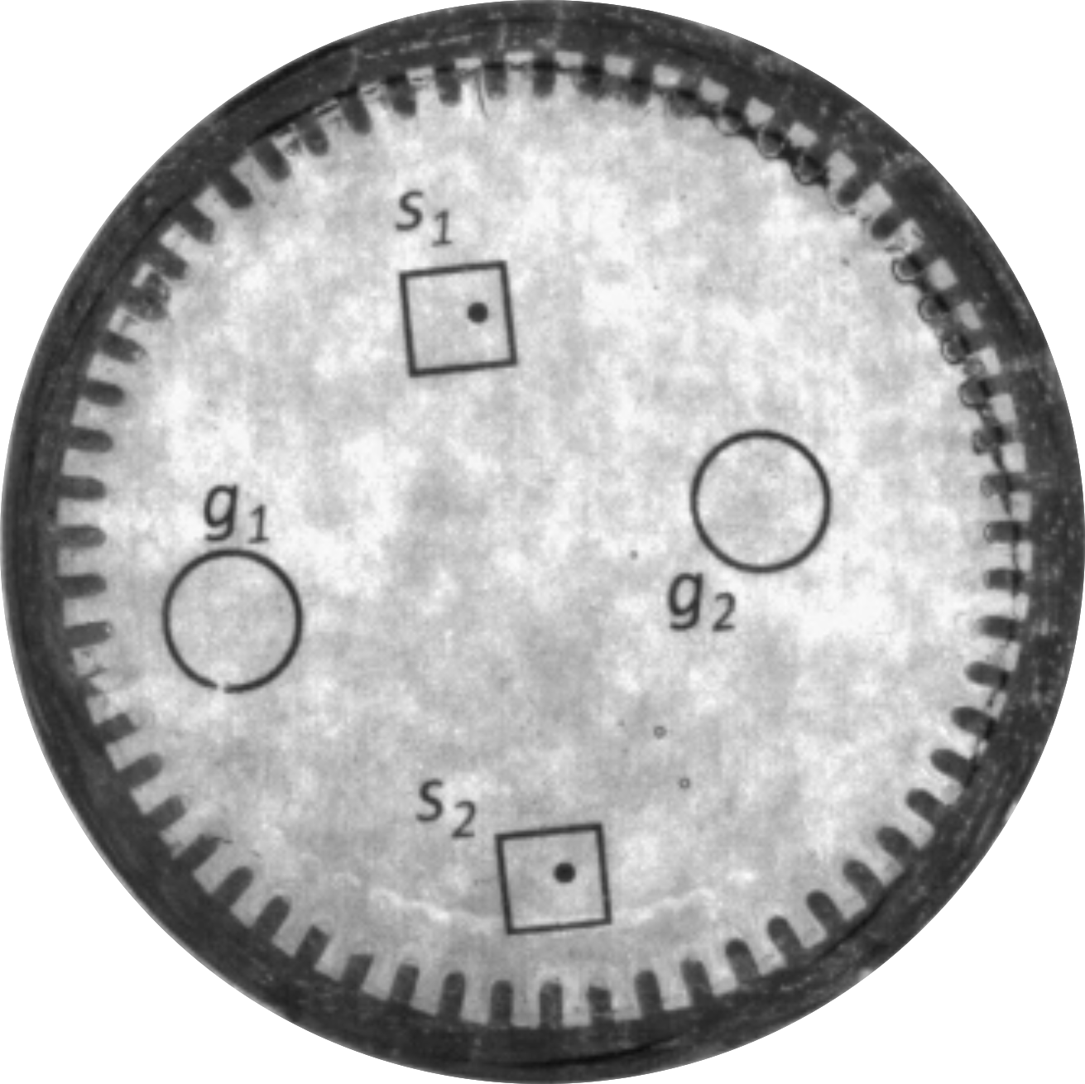
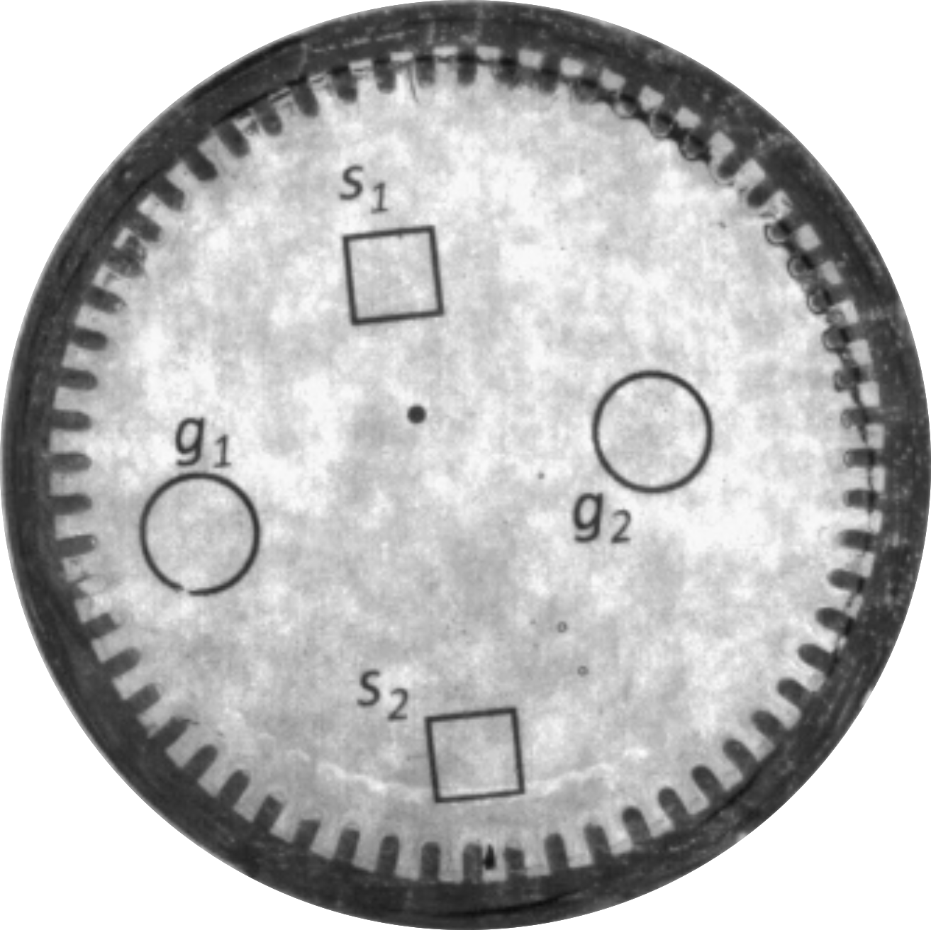



5 mm
5 mm
5 mm
5 mm
5 mm
1 mm magnets
m = 0
m = 1
m = 2
m = 3
m = 4

